Slide 1

Chapter 11
Health Services for Special Populations

Slide 2
Learning Objectives (1 of 2)
Population groups facing greater challenges and barriers in accessing health care services
Racial and ethnic disparities in health status
Children's health concerns and services
Women's health concerns and services
Rural health challenges and steps to care access

Slide 3
Learning Objectives (2 of 2)
Health concerns of the homeless population and migrant workers
Describe the U.S. mental health system
Summarize the AIDS epidemic in the U.S.
ACA benefits for vulnerable groups

Slide 4
Introduction (1 of 2)
Certain groups at greater risk of poor physical, psychological, or social health
Terms used
Underserved
Medically underserved
Medically disadvantaged
Underprivileged
American underclasses

Slide 5
Introduction (2 of 2)
Population groups
Racial and ethnic minorities
Uninsured children
Women
Rural area residents
Homeless population
Mentally and chronically ill
Disabled
HIV/AIDS

Slide 6
Framework to Study Vulnerable Populations
Vulnerability
Predisposing
Enabling
Need characteristics
Three vulnerability model characteristics
Comprehensive
General
Convergence

Slide 7
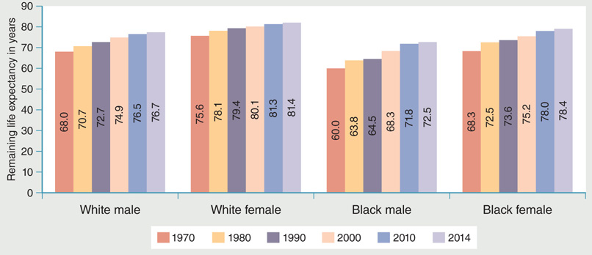
Figure 11-5: U.S. life expectancy at birth, 1970–2014.
Data from Health, United States, 2015, p. 93

Slide 8
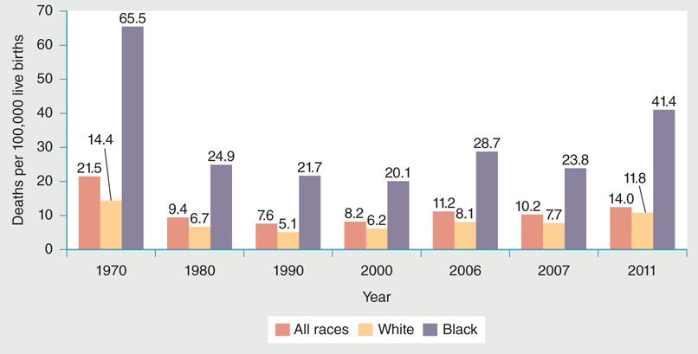
Figure 11-6: Age-adjusted maternal mortality rates.
Data from Health, United States, 2010, p. 231. Centers for Disease Control and Prevention (CDC). 2016. Pregnancy Mortality Surveillance System.
https://www.cdc.gov/reproductivehealth/maternalinfanthealth/pmss.html.

Slide 9
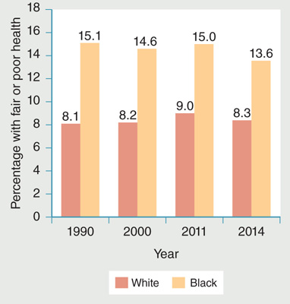
Figure 11-7: Respondent-assessed health status.
Data from Health, United States, 1995, p. 172, Centers for Disease Control and Prevention, National Center for Health Statistics, 1996,
Health, United States, 2012, p. 168, and Health, United States, 2015, p. 182.

Slide 10
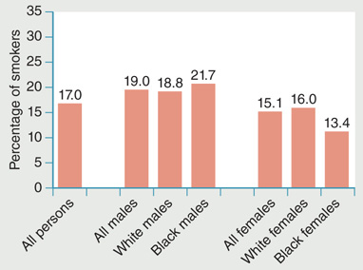
Figure 11-8: Current cigarette smoking by persons 18 years of age and over, age adjusted, 2014.
Data from Health, United States, 2015, p. 186, Centers for Disease Control and Prevention, National Center for Health Statistics.

Slide 11
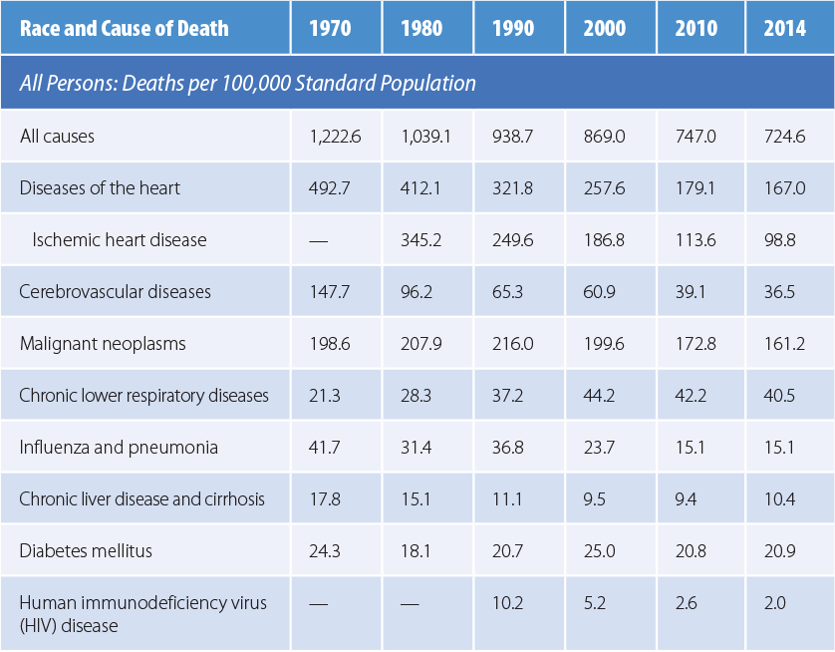
Table 11-2: Age-Adjusted Death Rates for Selected Causes of Death, 1970–2014

Slide 12
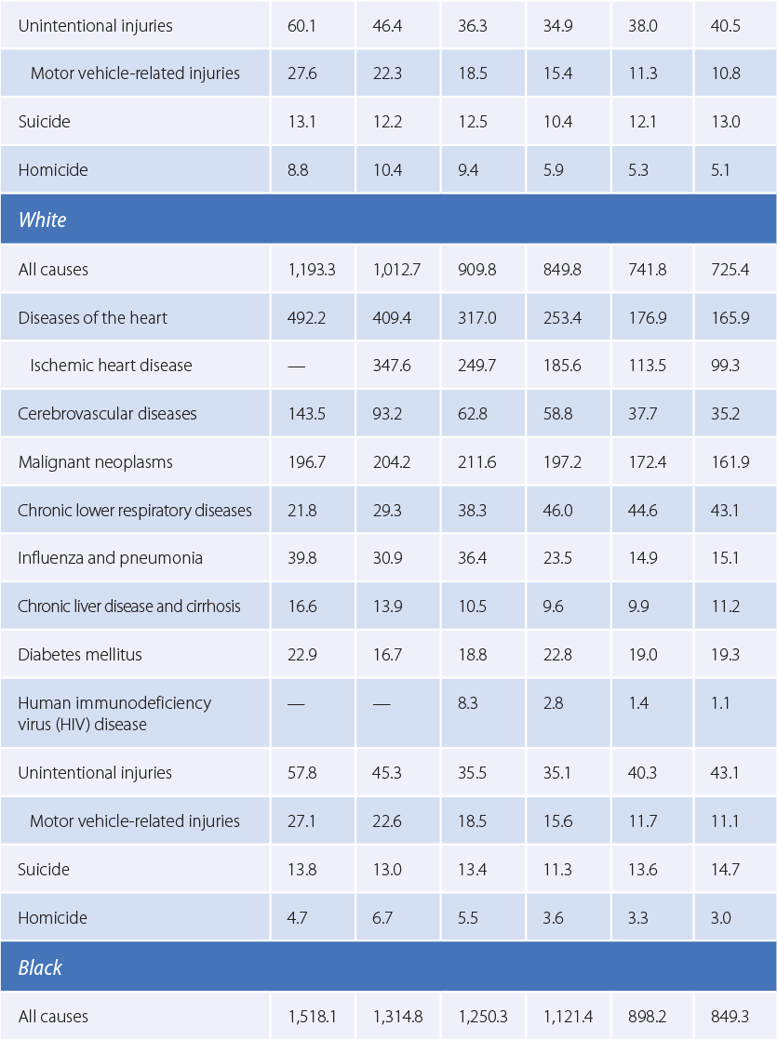

Slide 13
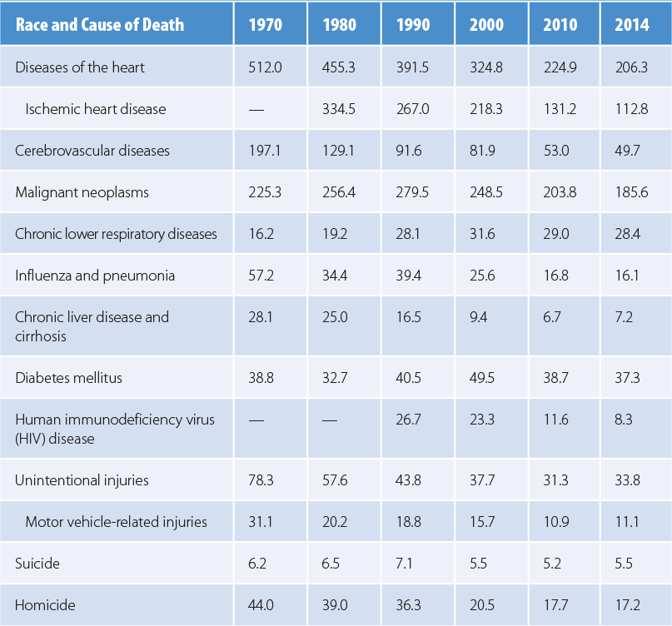
Data from Health, United States, 2015, Table 17, pp. 99–101, Centers for Disease Control and Prevention, National Center for Health Statistics.

Slide 14
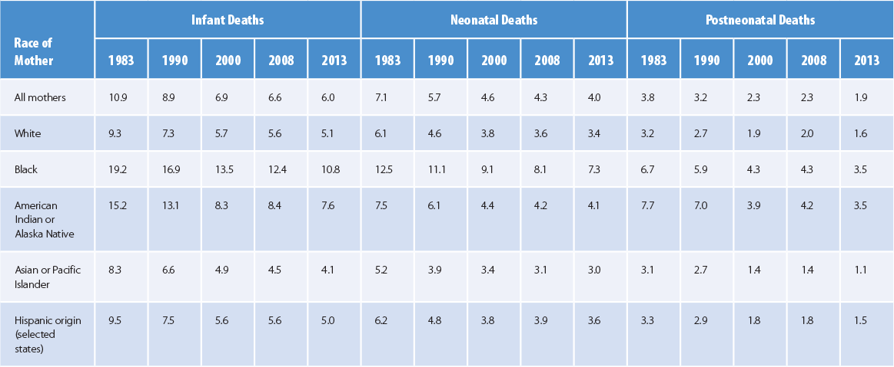
Table 11-3: Infant, Neonatal, and Postneonatal Mortality Rates by Mother’s Race (per 1,000 Live Births)
Data from Health, United States, 2015, p. 86.

Slide 15
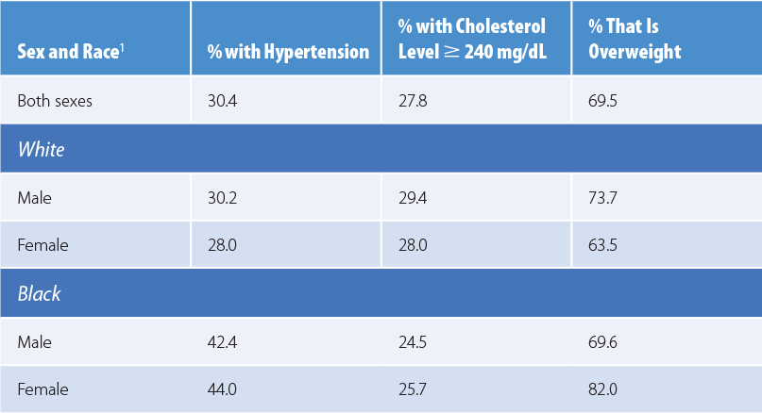
Table 11-4: Selected Health Risks Among Persons 20 Years and Older, 2011–2014
Data from Health, United States, 2015, pp. 202, 204, 216

Slide 16
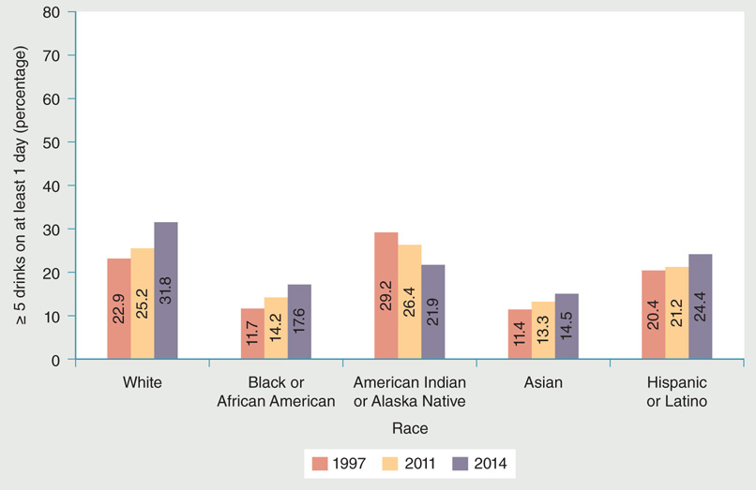
Figure 11-3: Alcohol consumption by persons 18 years of age and older, selected years.
Data from Centers for Disease Control and Prevention (CDC). National Health Interview Survey. https://www.cdc.gov/nchs/data/nhis/earlyrelease/earlyrelease201409_09.pdf.

Slide 17
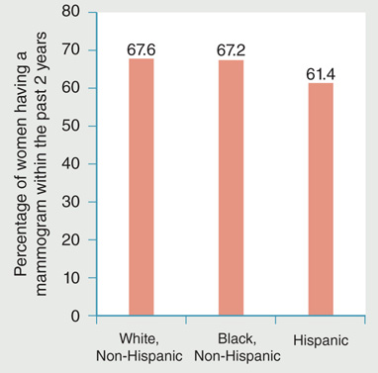
Figure 11-4: Use of mammography by women 40 years of age and older, 2013.
Data from National Center for Health Statistics (NCHS). 2016b. Health, United States, 2015. Hyattsville, MD: U.S. Department of Health and Human Services. p. 246.

Slide 18
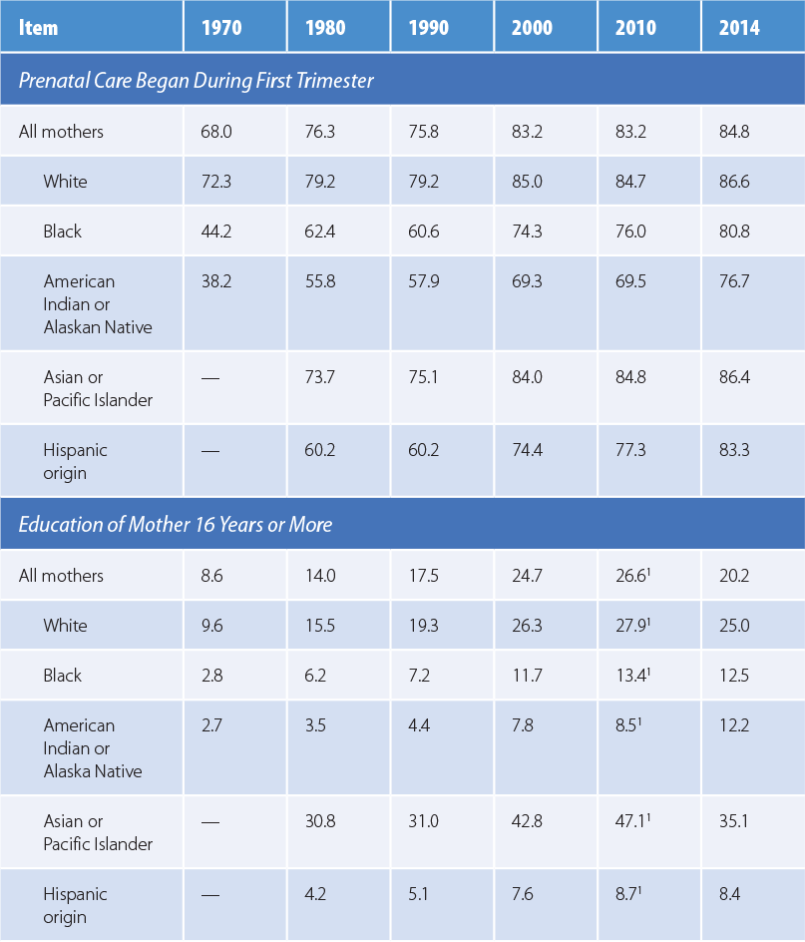
Table 11-1: Characteristics of U.S. Mothers by Race/Ethnicity

Slide 19
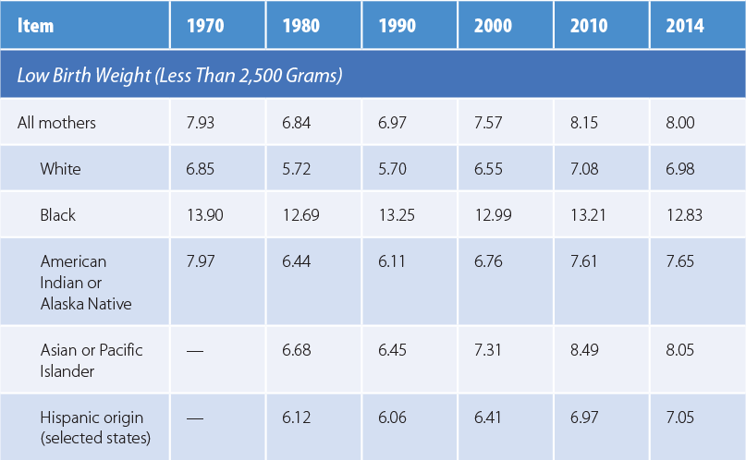
Numbers are percentages. *Data from 2008. Source: Data from Health, United States, 2015, p. 74; Health, United States, 2012, p. 144; Health, United States, 2009, pp. 159, 163

Slide 20
Racial/Ethnic Minorities: Asian Americans
In 2015, Asians accounted for only 5.6% of the U.S. population.
Asian Americans constitute one of the fastest-growing U.S. population segments.

Slide 21
Racial/Ethnic Minorities: American Indians and Alaska Natives
Incidence and prevalence of certain diseases in the AIAN population are a prime concern.
Higher death rates from alcoholism, tuberculosis, diabetes, injuries, suicide, and homicide.
Indian Health Care Improvement Act.
Indian Health Service.

Slide 22
Uninsured
Ethnic minorities are more likely than whites to lack health insurance.
Most of the uninsured population comprises young workers.
Uninsured persons are in poorer health than the general population.
ACA made progress in reducing the uninsured.

Slide 23
Children (1 of 2)
Health insurance is a major determinant of access to and utilization of health care.
Coverage rates vary across races and ethnicities.
Unintentional injuries are the leading cause of death for children and adolescents.
Asthma is a common childhood chronic disease.
Depression has an impact on adolescent development.

Slide 24
Children (2 of 2)
Children’s health has certain unique aspects.
Developmental vulnerability and dependency
Children and the U.S. health care system
Programs categorized into three sectors
Personal medical and preventive services
Population-based community health services
Health-related support services

Slide 25
Women
Office on Women’s Health
Specific goals that span the spectrum of disease and disability
Women and the U.S. health care system
At a disadvantage in obtaining employer-based health insurance
See Figure 11-10

Slide 26
Rural Health (1 of 2)
National Health Service Corps
Health professional shortage areas
Health Professions Educational Assistance Act
Three types of HPSAs by geographic areas, population groups, and medical facilities

Slide 27
Rural Health (2 of 2)
Medically underserved areas
Percentage of population below poverty income levels
Percentage of population 65 years of age and older
Infant mortality rates
Number of primary care practitioners per 1,000 population

Slide 28
Migrant Workers
Community and migrant health centers
Rural Health Clinics Act
Concern rural areas could not support a physician
Permitted PAs, NPs, and CNMs with rural clinics to practice without the direct supervision of a physician
Enabled rural health clinics to be reimbursed by Medicare and Medicaid

Slide 29
Homeless
Approximately 1 in 200 people became homeless in 2011.
Adult population is 63% men and 37% women.
Estimated 22.8% are children under age 18.
35.8% are families with children.
14% are veterans.
Shortage of adequate low-income housing.
Barriers to health care.

Slide 30
Mental Health
Barriers to mental health care
Uninsured and mental health
Insured and mental health
Managed care and mental health
Mental health professionals
See Table 11-7

Slide 31
Chronically Ill
Chronic diseases are the leading cause of death in the U.S.
Result in limitations on daily life activities.
Treatment accounts for 86% of U.S. health costs.
Disability
Categorized as mental, physical, or social
Disability tests

Slide 32
HIV/AIDS (1 of 3)
Number of AIDS cases reported
Increased between 1987 and 1993
Decreased between 1994 and 1999
Increased between 2000 and 2004
Decreased since 2005
HIV Infection in rural communities
HIV in children

Slide 33
HIV/AIDS (2 of 3)
HIV in women
HIV/AIDS-related issues
Need for research
Public health concerns
Discrimination
Provider training

Slide 34
HIV/AIDS (3 of 3)
Cost of HIV/AIDs
See Figure 11-12
AIDS and the U.S. health care system
AIDS is characterized by a gradual decline in physical, cognitive, and emotional function.
As HIV disease progresses, many people become disabled and rely on public entitlements.

Slide 35
Summary
Challenges and barriers in accessing health care services for certain population groups.
Health needs of these population groups vary.
Gaps exist between population groups and the rest of the population.

